Slide 1
18th Webmedia Aniversary
A retrospective of Webmedia´s history
Fernando Trinta

Slide 2
My Agenda
Three Steps
Reviewing previous editions
Showing some numbers
Webmedia´s relevance

Slide 3
Reviewing Previous editions
Step One

Slide 4
I Workshop on Multimedia and HyperMedia Systems
ICMC-USP – São Carlos/SP – 1995, Jul 7th-8th
PROTEM-CC
Two projects:
HyperProp:
Open Hypermedia Systems and Applications
Coord: Luiz Fernando Soares (PUCRio)
SMmD: Distributed Multimedia Systems: Support, infrastructure & applications
Cesar Teixeira (UFSCar)
Local Coordination: Maria da Graça Pimentel

Slide 5
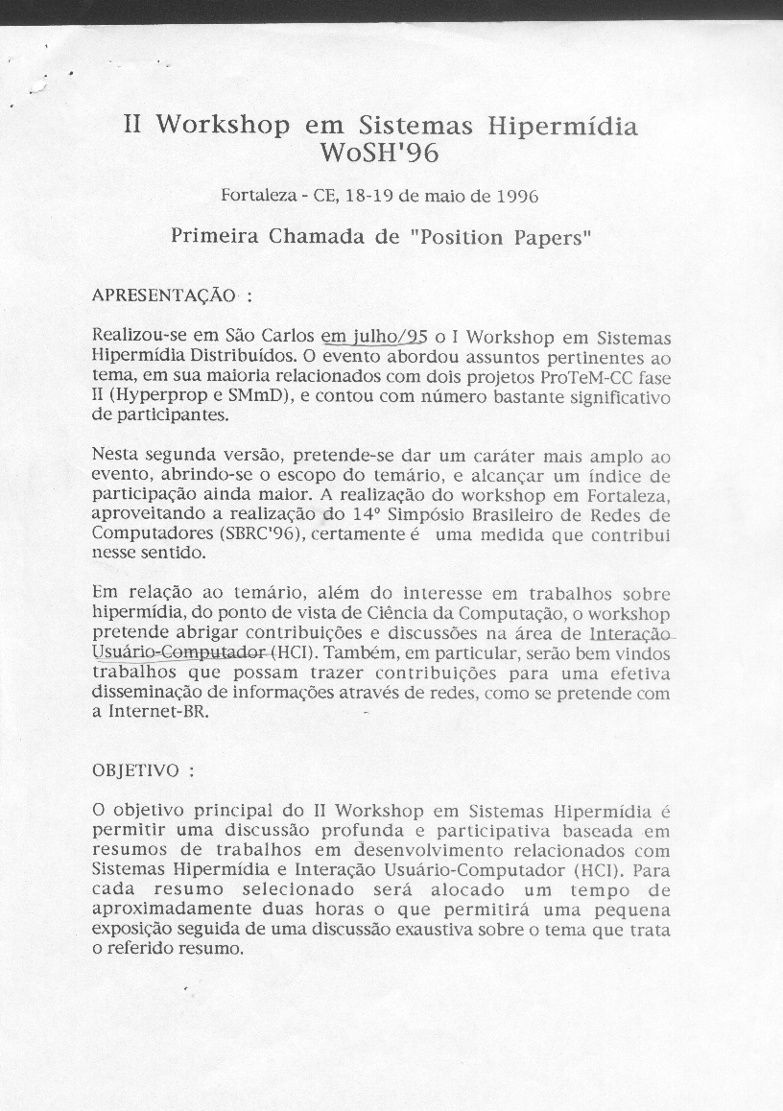
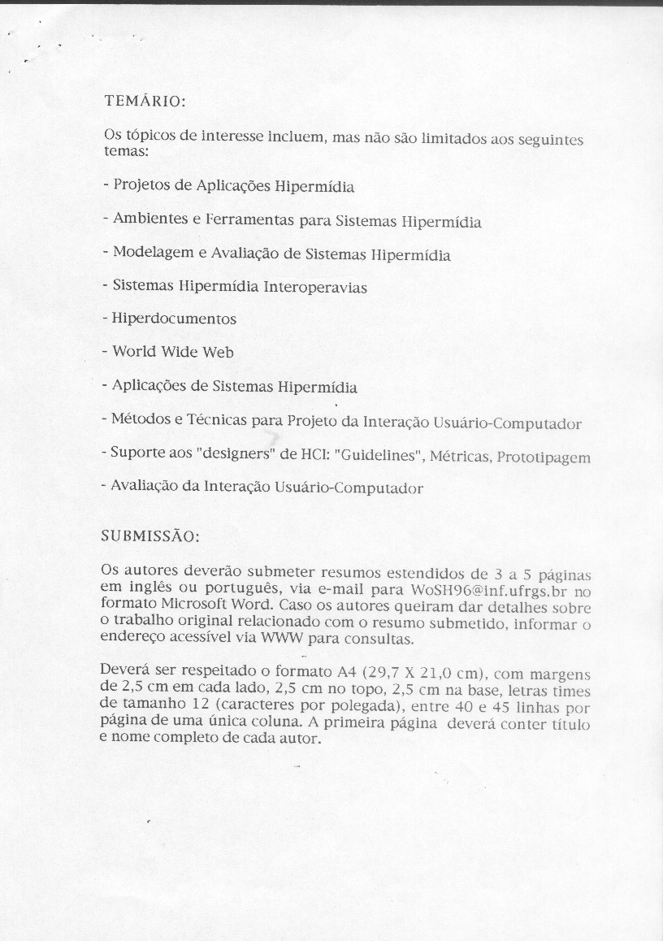
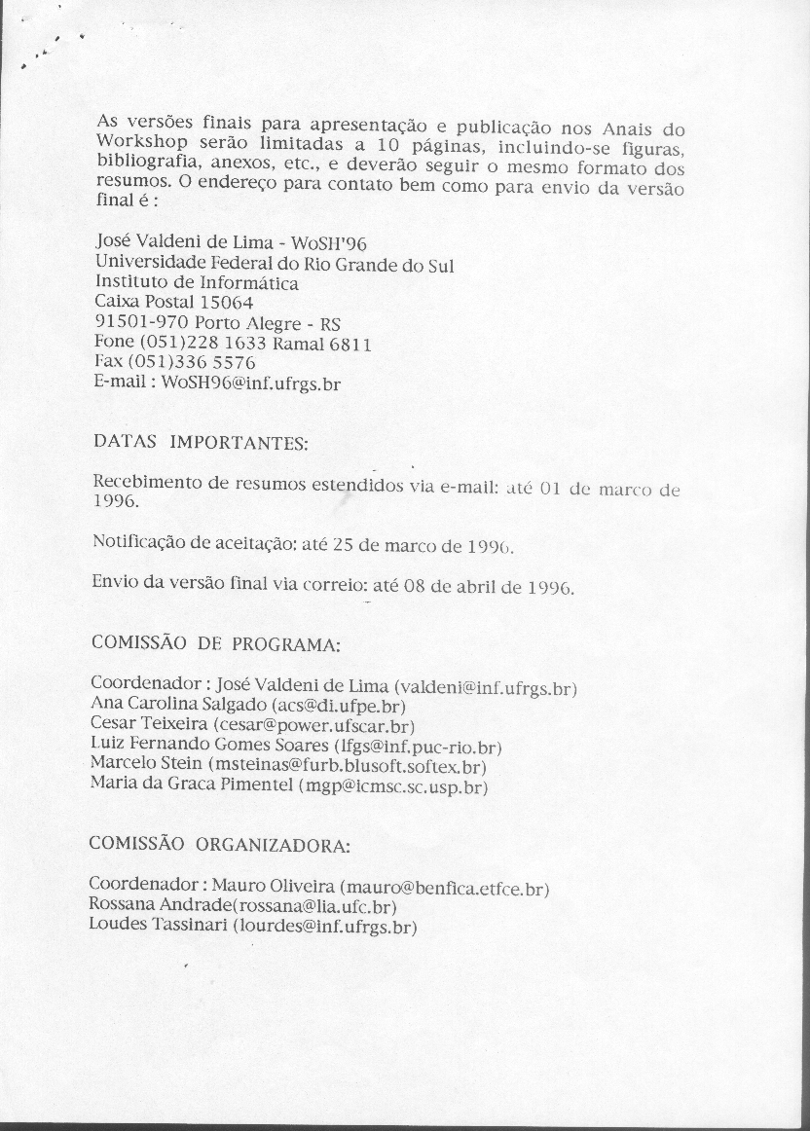
II Workshop on Multimedia and HyperMedia Systems
CEFET/UECE/UFC – Fortaleza/CE – 1996, Jul 7th-8th
Local Chair: Mauro Oliveira (CEFET) & Rossana Andrade(UFC)
PC Chair: José Valdeni de Lima (UFRGS)
Jointly with the Brazilian Symposium on Computer Networks
1st Call for Papers

Slide 8
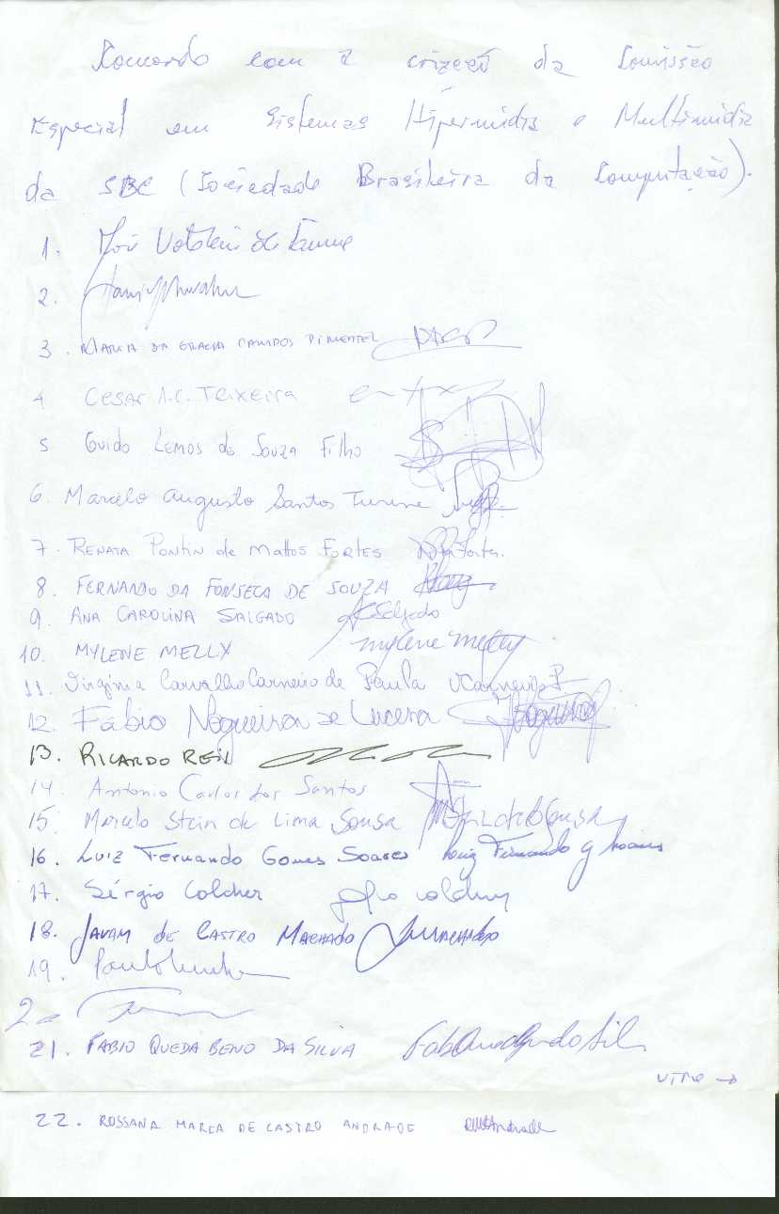
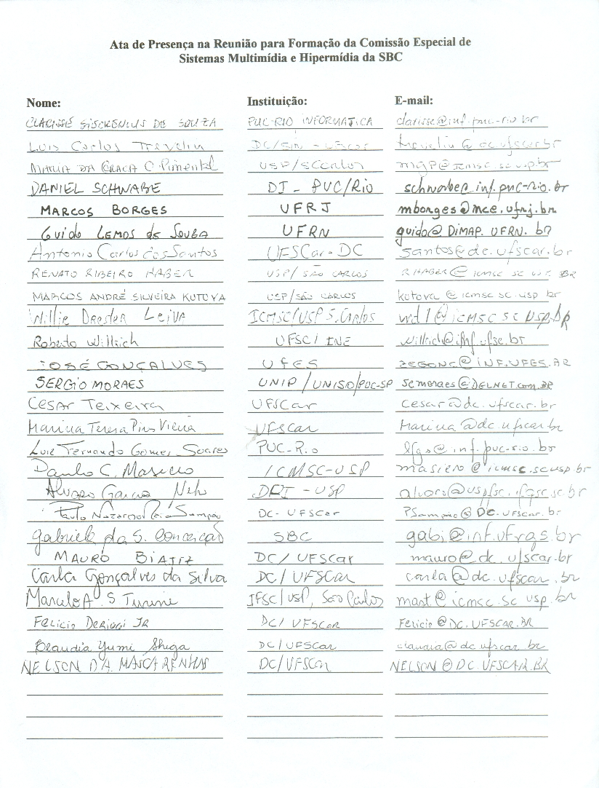
Special Commission of Multimedia and Hypermedia Systems
Petition

Slide 9
III Workshop on Multimedia and HyperMedia Systems
ICMC-USP – São Carlos/SP – 1997, May 23rd-25th
Local Chair: Maria da Graça Pimentel (ICMC-USP)
PC Chair: Luis Fernando Gomes Soares (PUC-Rio)

Slide 10
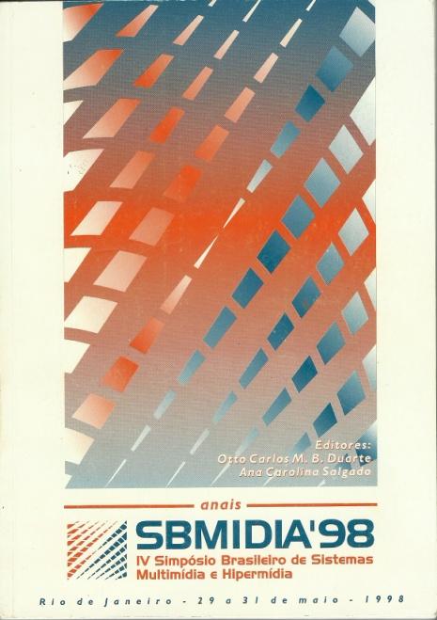
IV Brazilian Symposium on Multimedia and HyperMedia Systems
UFRJ – Rio de Janeiro/RJ – 1998, May 29th-31st
Local Chair: Otto Bandeira Duarte (UFRJ)
PC Chair: Ana Carolina Salgado (UFPE)
New Acronym: SBMídia
Best papers were selected to
IEEE Multimedia
Journal of Multimedia Tools and Applications

Slide 11
V Brazilian Symposium on Multimedia and HyperMedia Systems
UFG – Goiânia/GO – 1999, Jul 15th-17th
Local Chair: Eduardo Simões de Alburquerque (UFG)
PC Chair: Guido Lemos de Sousa Filho (UFRN)
Jointly with an Industry Conference
Goiás TELECOM & IT Conference

Slide 12
VI Brazilian Symposium on Multimedia and HyperMedia Systems
UFRN – Natal/RN – 2000, Jul 14th-16th
Local Chair: Guido Lemos de Souza Filho (UFRN)
PC Chair: Daniel Schwabe (PUC-Rio)
No partnerships...

Slide 13
VII Brazilian Symposium on Multimedia and HyperMedia Systems
UFSC – Florianópolis/SC – 2001, Oct 15th-19th
Local Chair: Roberto Willrich (UFSC)
PC Chair: Cesar Teixeira (UNIFACS)
Jointly with :
Brazilian Symposium on Computer Graphics
Workshop on Human Factor in Computer Systems
Symposium on Virtual Reality
Short papers were introduced
1st M.Sc. and Ph.D. Workshop
Chair: Maria da Graça Pimentel
Notes:
8 papers wtd
14 short papers – ongoing work work in progress, they were present as posters.

Slide 14
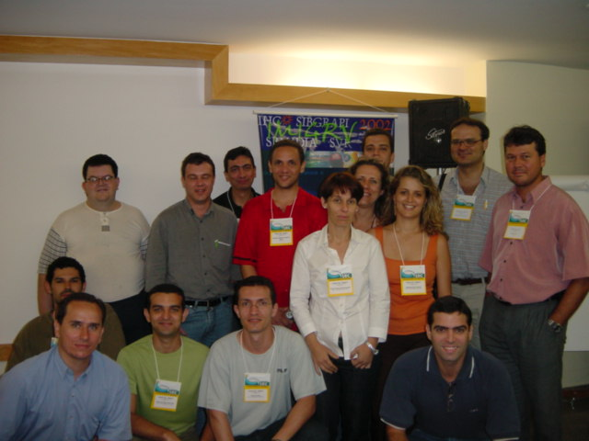
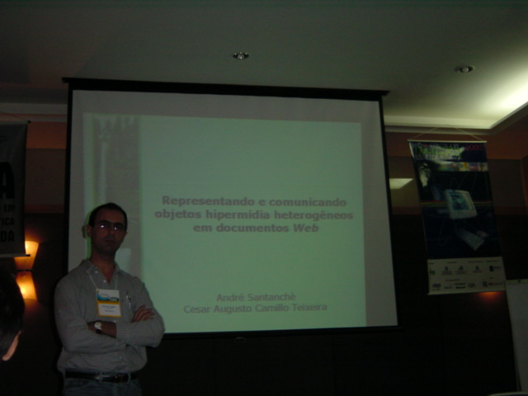
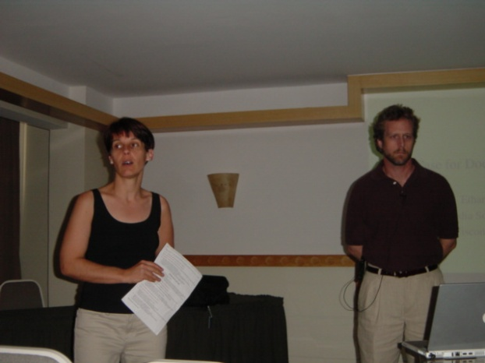
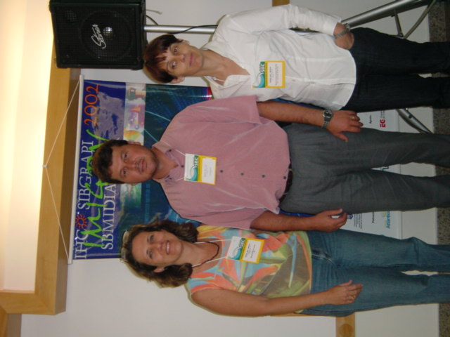
VIII Brazilian Symposium on Multimedia and HyperMedia Systems
UFC – Fortaleza/CE – 2002, Oct 7th-10th
Local Chair: Riverson Rios (UFC)
PC Chair: Maria da Graça Pimentel (ICMC-USP)
1st Worshop on Tools and Applications
Chair: Renata Fortes (ICMC-USP)
Notes:
12 tools were present

Slide 15
IX Brazilian Symposium on Multimedia Systems and Web
UNIFACS – Salvador/BA – 2003, Nov 3rd-6th
Local Chair: Celso Saibel & Joberto Martins (UNIFACS)
PC Chair: Guido Lemos de Souza Filho (UFPB)
New Acronym: WebMídia
New format: Two tracks
CSCW
Renata Mendes de Araújo (UNIRIO) e Flávia Maria Santoro (NCE–UFRJ)
Middleware for Multimedia
Fabio Kon (USP) e Renato Cerqueira (PUC–Rio)
First Time: Posters
Notes:
Artigos com formatos diferentes. 16 e 8 páginas
Name changed to web

Slide 16
X Brazilian Symposium on Multimedia Systems and Web
ICMC-USP – Ribeirão Preto/SP – 2004, Oct 12th-15th
Local Chair: Cesar Teixeira (UFSCar) & Renata Fortes (ICMC-USP)
PC Chair: Maria da Graça Pimentel (ICMC-USP) & Ethan Munson (Univ. Wisconsin)
Jointly with Latin America Web (LAWeb)
Two tracks
Portuguese/Spanish
English
1st Undergraduate Research Workshop
Proceedings were sent to IEEE & ACM
Notes:
Latin American Web Congress - International World Wide Web Conference Committee and its proceedings will be published by the IEEE Computer Society Pr
Two proceedings -

Slide 17
XI Brazilian Symposium on Multimedia Systems and Web
PUC Minas – Poços de Caldas/MG – 2005, Dec 5th-7th
Local Chair: Eduardo Barrere, Iran C. Abrão & João Benedito dos S. Junior (PUC Minas)
PC Chair: Renata Fortes (ICMC-USP)
1st Workshop on Digital TV

Slide 18
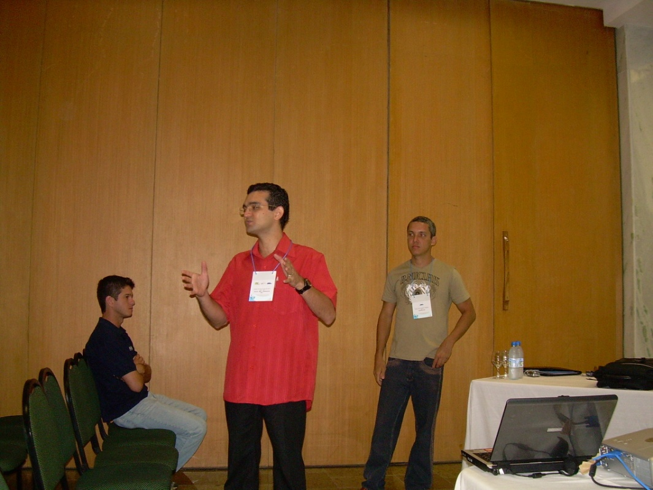
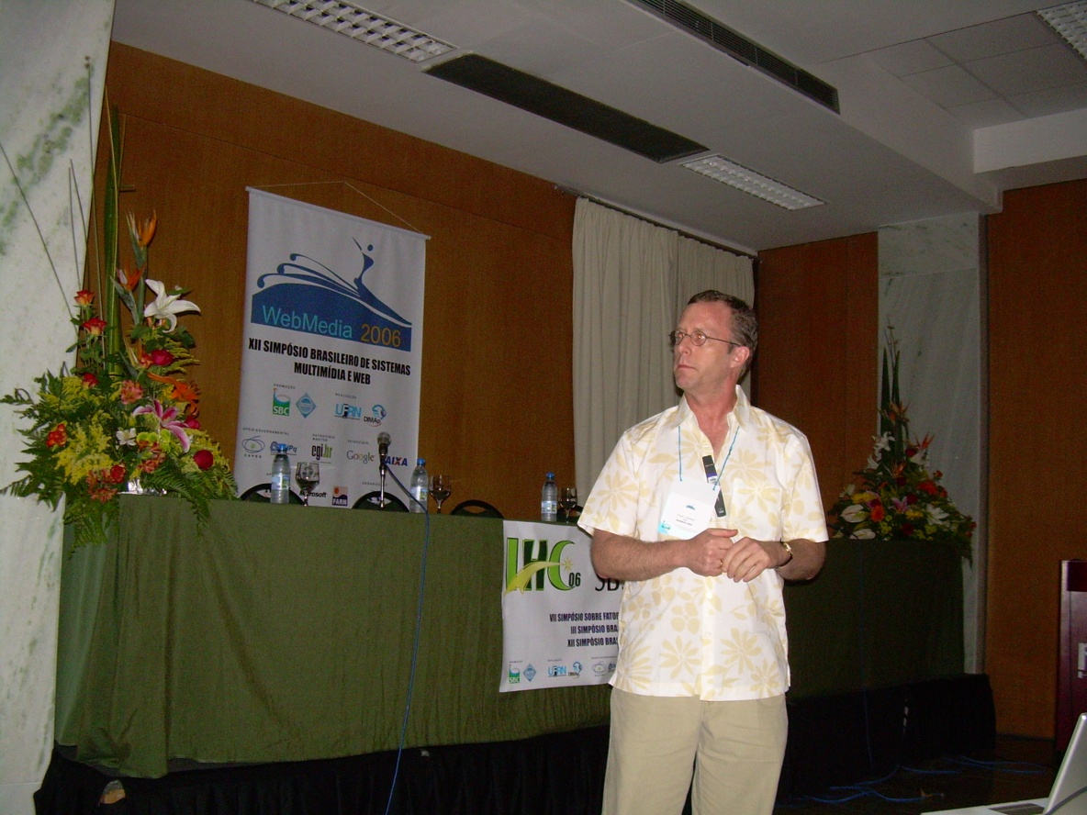
XII Brazilian Symposium on Multimedia Systems and Web
UFRN – Natal/RN – 2006, 19th-22th
Local Chair: Rogério Ferreira Rodrigues (PUC-Rio) Jair C. Leite (UFRN)
PC Chair: Luiz Fernando Gomes Soares (PUC-Rio)
Jointly with:
Symposium on Human Factors on Computing Systems
Brazilian Symposium on Collaborative Systems

Slide 19
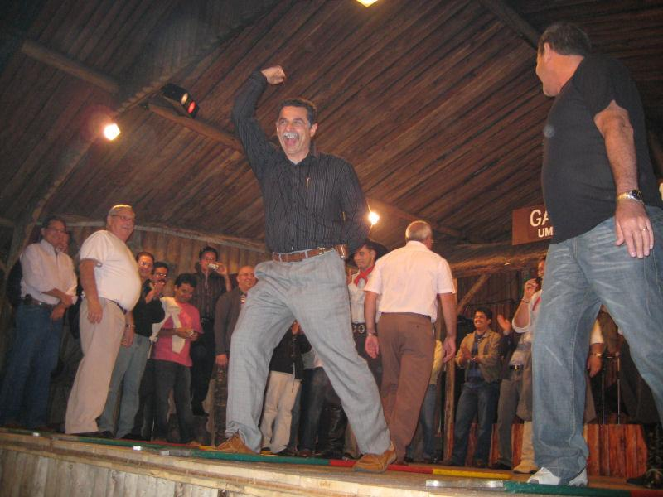
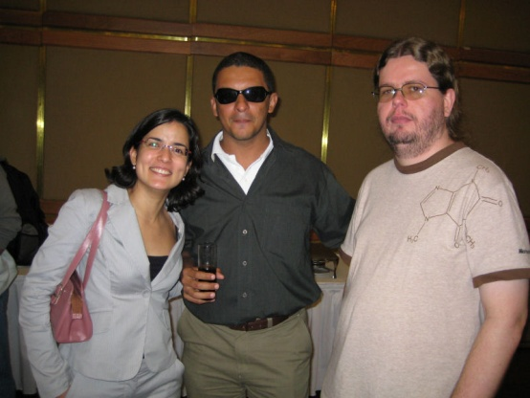
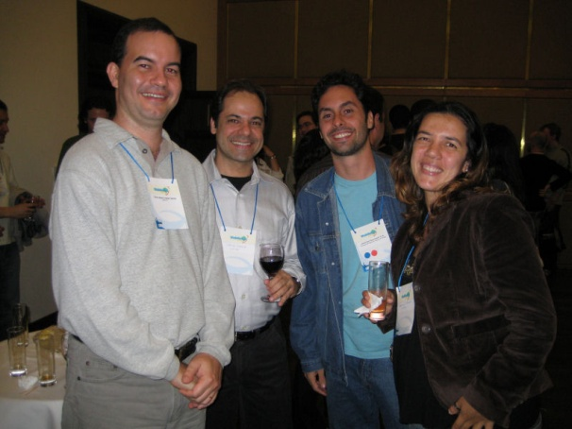
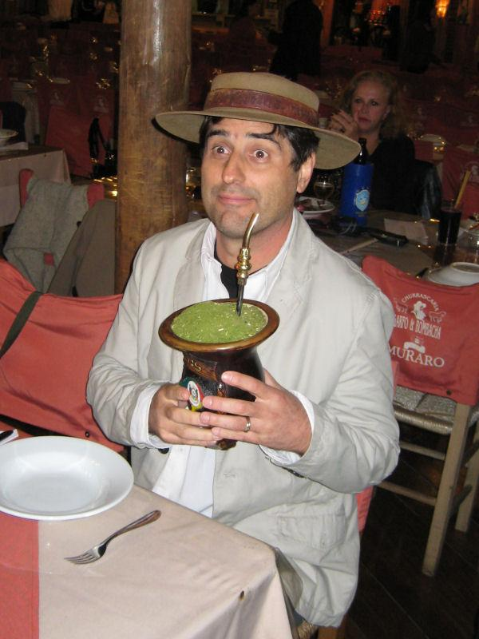
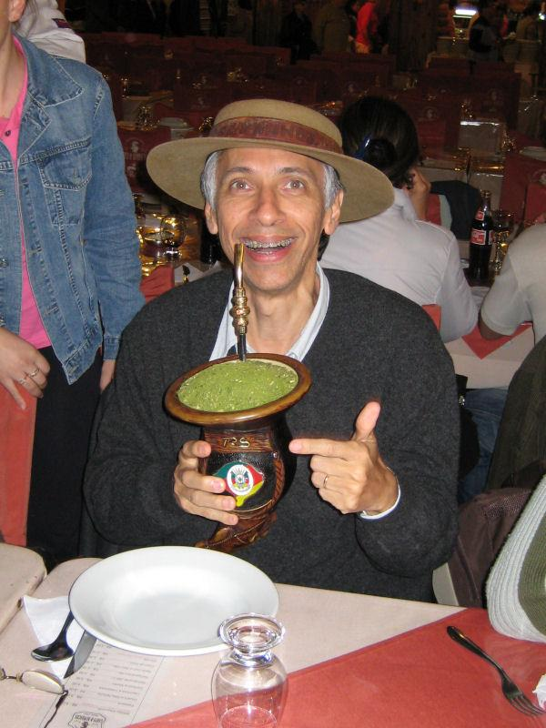
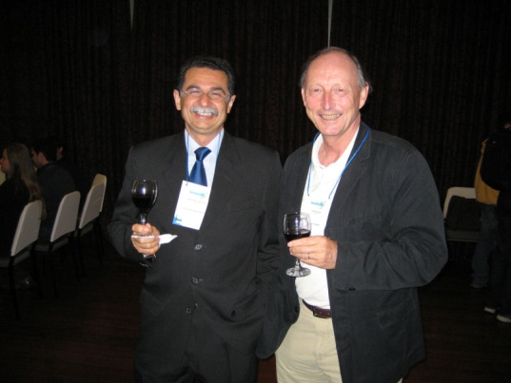
XIII Brazilian Symposium on Multimedia Systems and Web
UFGRS – Gramado/RS – 2007, Oct 21st-24th
Local Chair: José Valdeni de Lima (UFRGS)
PC Chair: Carlos André Guimarães Ferraz (UFPE)
Workshop on Business Process Management
International Symposium on Computer Architecture and High Performance Computing

Slide 20
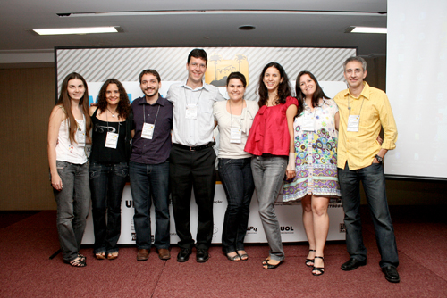
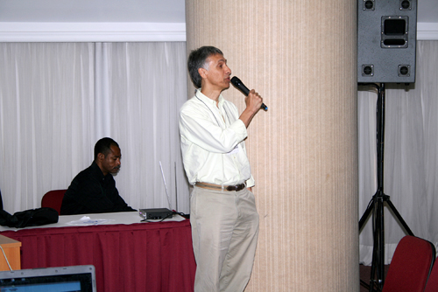
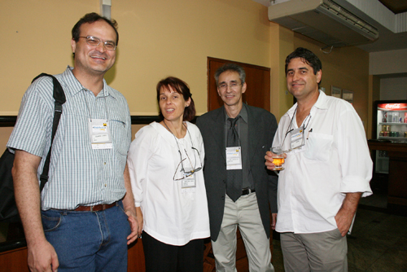
XIV Brazilian Symposium on Multimedia Systems and Web
UFES – Vila Velha/ES – 2008, Oct 26th-29th
Local Chair: José Gonçalves Pereira Filho (UFES)
PC Chair: Celso Alberto Saibel Santos (Unifacs) & Rogério Ferreira Rodrigues (FAST / PUC-Rio )
Jointly with LA-Web & Brazilian Symposium on Colaborative Systems
Notes:
II Workshop on Business Process Management
VI Workshop on Information and Human Language Technology
VI Latin American Web
largest number of registered

Slide 21
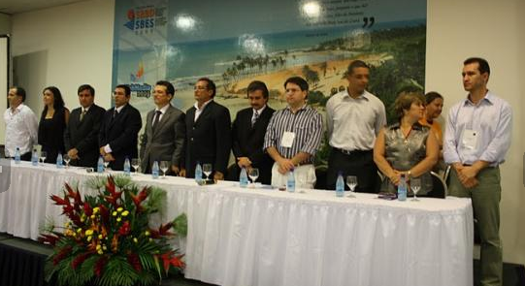
XV Brazilian Symposium on Multimedia Systems and Web
UNIFOR – Fortaleza/CE – 2009, Oct 5th-7th
Local Chair: Fernando Trinta & Pedro Porfírio (UNIFOR)
PC Chair: Renata Fortes & Rudinei Goularte (ICMC-USP)
Jointly with SBBD, SBES, SBSC
Best papers were sent to JBCS

Slide 22
XVI Brazilian Symposium on Multimedia Systems and Web
UFMG– Belo Horizonte/MG – 2010, Oct 3rd-5th
Local Chair: Eduardo Barrére (UFJF)
CP Chair: Jussara Almeida (UFMG)
Jointly with SBBD, SBSC & IHC

Slide 23
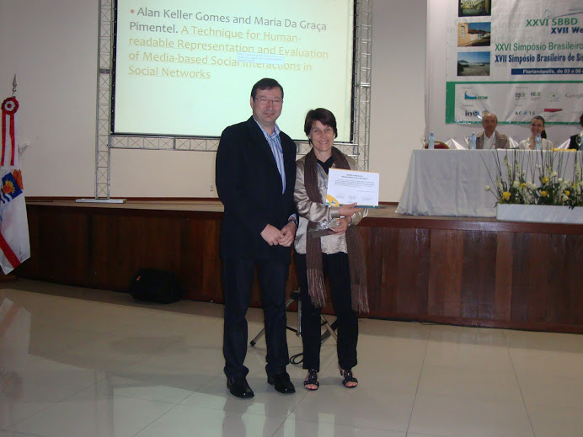
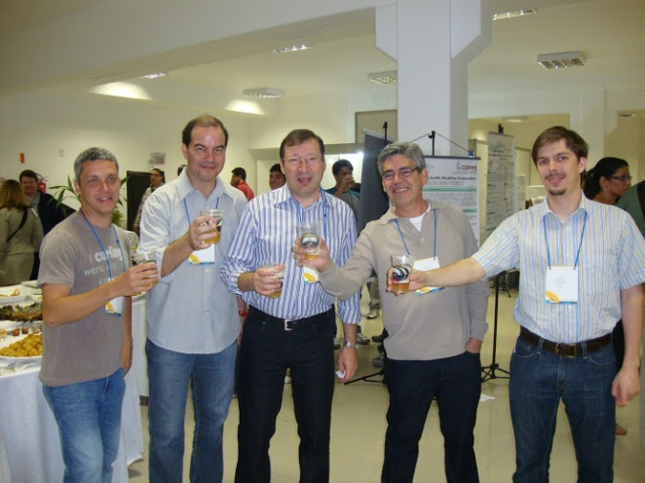
XVII Brazilian Symposium on Multimedia Systems and Web
UFSC – Florianópolis/SC – 2011, Jul 3rd-6th
Local Chair: Roberto Willrich (UFSC)
CP Chair: José Valdeni de Lima (UFRGS)

Slide 24
XVIII Workshop on Multimedia and HyperMedia Systems
USP – São Paulo/SP – 2012, Oct 15th-18th
Local Chair: Graça Bressan (USP) & Regina Melo (USP)
CP Chair: Maria da Graça Pimentel (ICMC-USP)
Ethan Munson (Multimedia)
André Santachè (Web & Social Networks)
Proceedings are already online!!!
Rebuttal phase
Notes:
I miss CDs

Slide 25
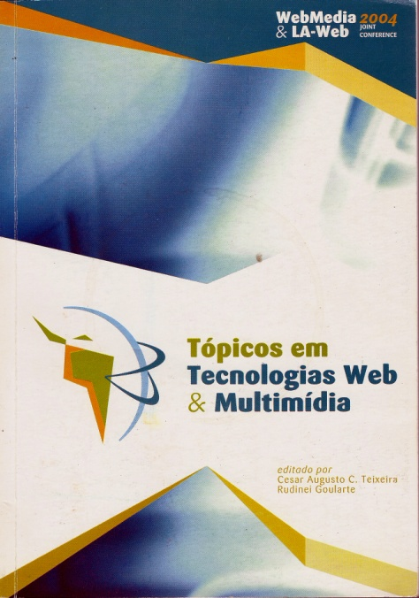
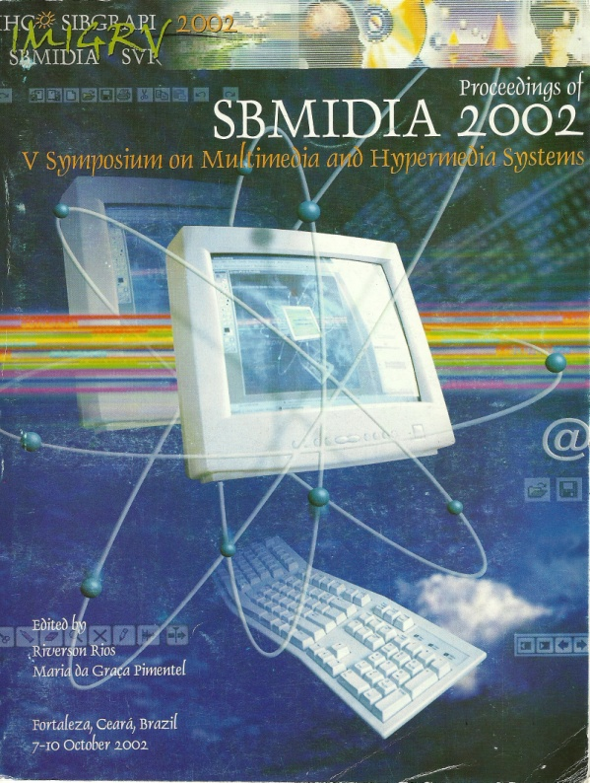
Showing some numbers
Step Two

Slide 26
Submission x Acceptance

Slide 27
Acceptance Rate

Slide 28
PC Growth

Slide 29
Papers per Reviewer

Slide 30
More numbers???
Mapping WebMedia´s papers ...
Papers per author?
Papers per institution?
Papers per idiom?
Papers per Brazilian State?
Papers per Research Topic?

Slide 31
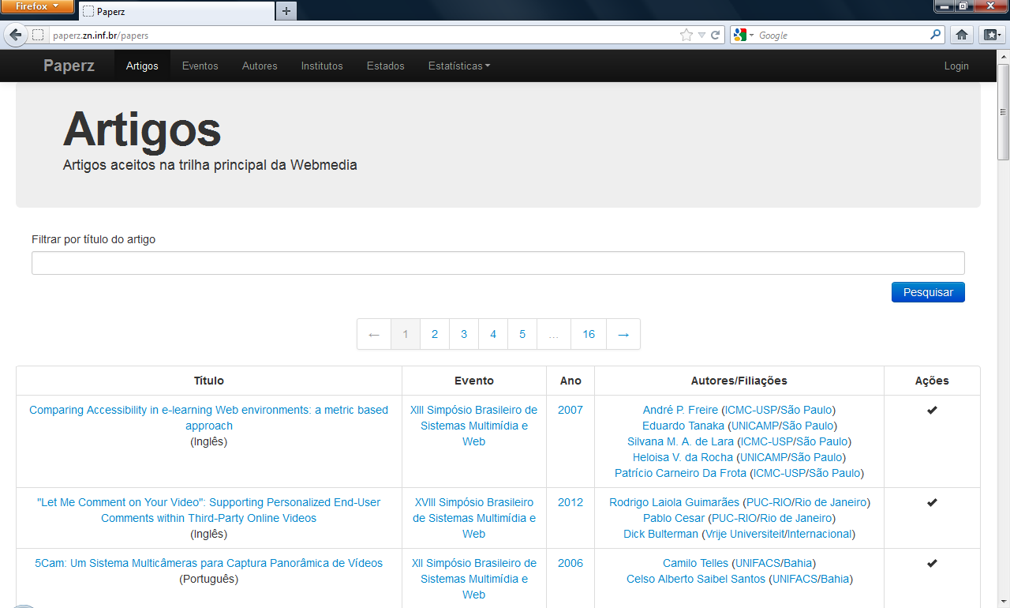
An Web Application...
Full papers only
Papers info:
Title
Author
Affiliation
State
Avaliable at:
http://paperz.zn.inf.br

Slide 32
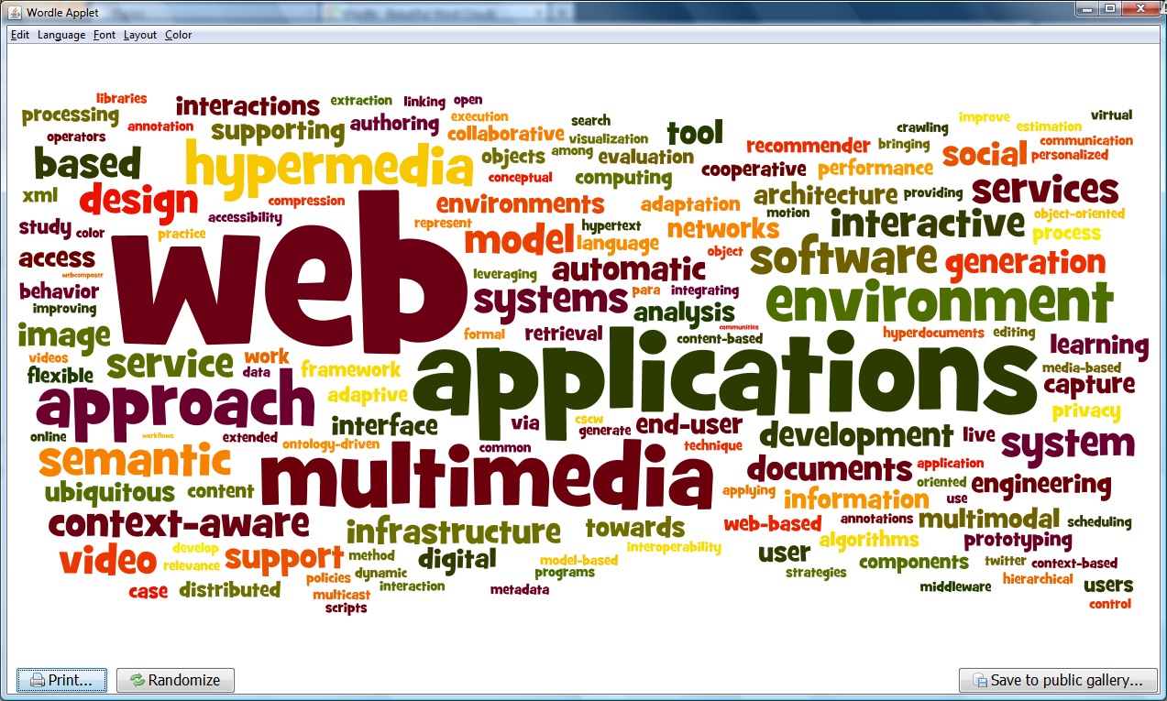
Words Cloud
Papers Written in English

Slide 33
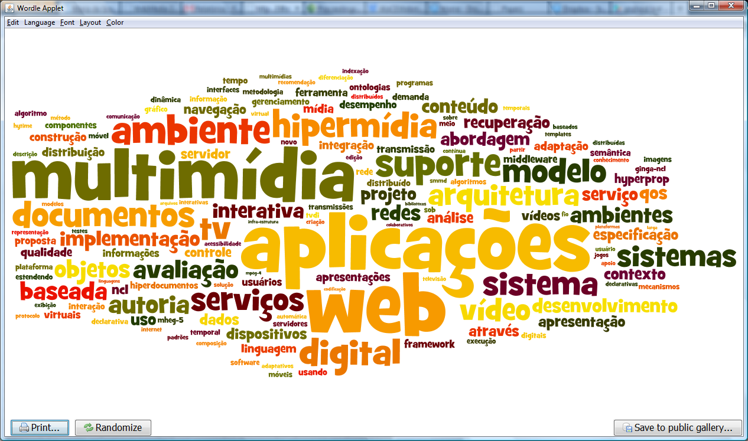
Words Cloud
Papers Written in Portuguese

Slide 34
Webmedia´s IMpact
Step Three

Slide 35
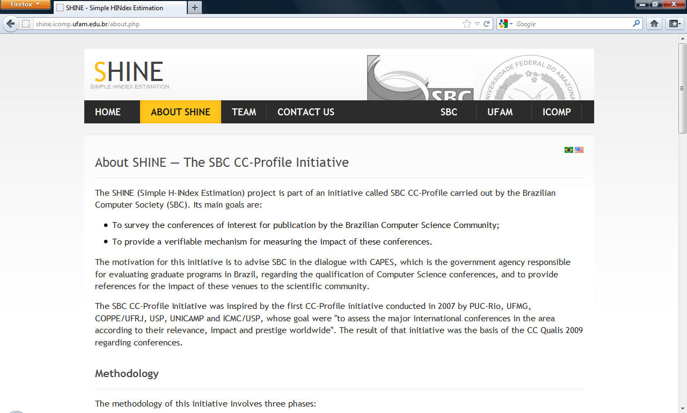
WebMedia´s H-Index (1/2)
Quallis-CC: B3
H-Index
Shine
http://shine.icomp.ufam.edu.br

Slide 36
WebMedia´s H-Index (2/2)
WebMedia issues:
Several names: WOSH, SBMídia, Webmídia, Webmedia...
Older proceedings are not online...
Portuguese...
What we could do?
Put older proceedings online...
English ONLY..

Slide 37
Concluding...
Final Step

Slide 38
acknowledgments
WebMedia 2012
Maria da Graça Pimentel
Graça Bressan
Regina Melo
GREat Team
Ricardo Viana
Paulo Arthur
Senior Webmedia researchers
Valdeni Lima, Cesar Teixeira, Celso Saibel, Valter Roesler, ...

Slide 39
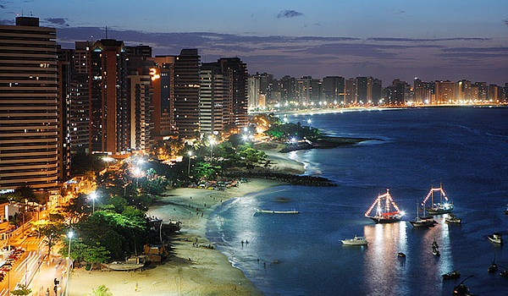
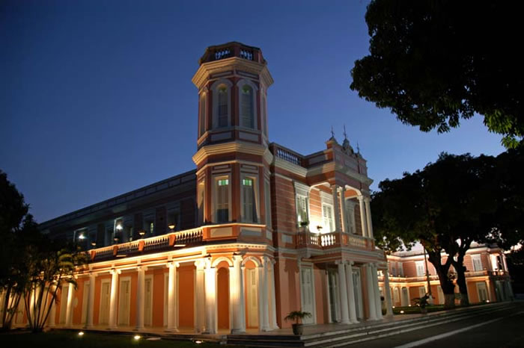
Contact
Fernando Trinta
Computer Networks, Software Engineering and Systems Research Group (www.great.ufc.br)
MSc and PHd Program in Computer Science – UFC (www.mdcc.ufc.br)
http://www.lia.ufc.br/~fernando.trinta

